Slide 1
超越学科界限的认知基础 Transdisciplinary Cognitive Foundation Namespace Management Week 2
Ben Koo
September 22, 2021

Slide 2
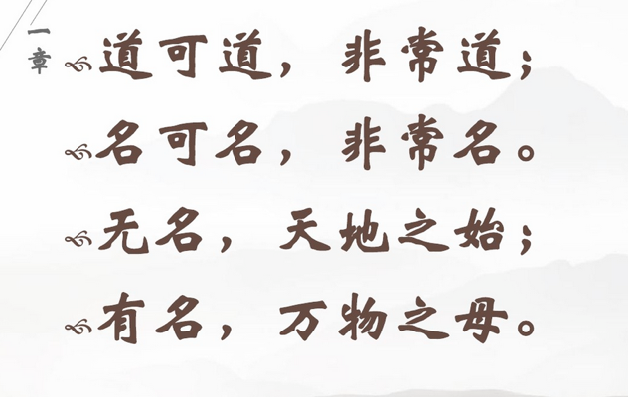

Names gave birth to Cognitive Abilities - Laozi
Huawei VP Mr. Yang Shaoqing
RICH 70 Tsinghua SEA Cloud Forum, Sep 14, 2020
H. E. Bambang Brodjonegoro,
Minister of Research & Technology, Indonesia

Slide 3
associate institutionalized meaning to
a set of discrete names.
Digital Transformation is an intentional act to...
The technical terminology in ICT field is: Namespace Management
Notes:
(notes)
Make sure that they understand that working with the three challenge projects is to show them that all these principles exist in these organizations. We change the way they view the world so they can solve problems in their own environments
Page services files
Dev Sec Ops
Tools
Work flow

Slide 4
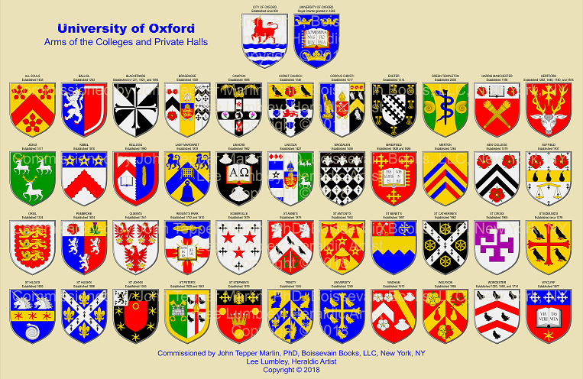

Governing process for issuing Coat of Arms
Coat of arms is a systematically governed mechanism to declare organizational identity and embed their respective cultural content in unique symbols/digits. Since the number of organization will evolve over time, the total number of symbols/digits will also evolve overtime.
Please refer to the Definition, History, Symbols, & Facts page of Encyclopedia, Britannica.
Notes:
Becoming a data governor MEANS being able to be empowered to participate in the exponential data economy and to stay relevant WHILE being able to meaningfully contribute to society and current risks and challenges we face collectively.

Slide 5

Coat of Arms Governance -> Namespace Management
Just imagine these icons are somehow mixed up and misrepresenting each other...

Slide 6
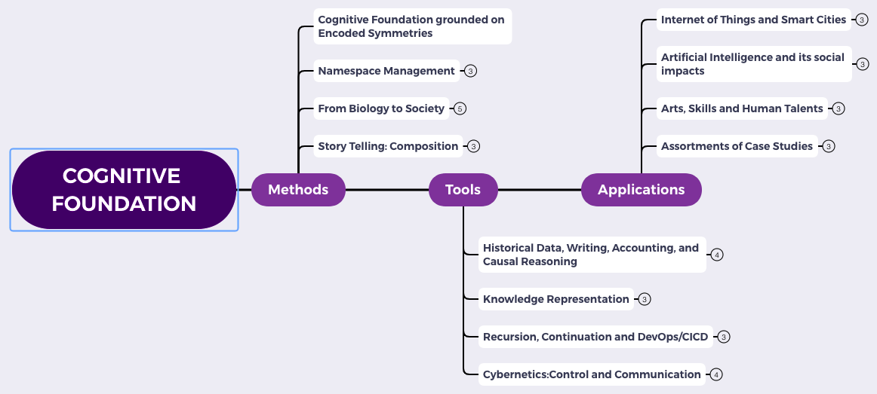
Content Themes for the semester
Overview
Namespace Management
Biology, Physics, Math, Code is Law, and Society
Story Telling, Functions/Metaphors/Analogies
Writing, Accounting, Historical Data and Temporal Reasoning
Knowledge Representation in Wiki and Files
Recursion and Continuation (DevOps/CICD)
Midterm Reports by Students
Cybernetics (Control and Communication)
Smart City and Internet of Things
Artificial Intelligence and its Social Impacts
Arts/Skills/Human Talents in the Digital Era
Student proposed Application Topics
Rehearsal
Final Reports and Celebration

Slide 7
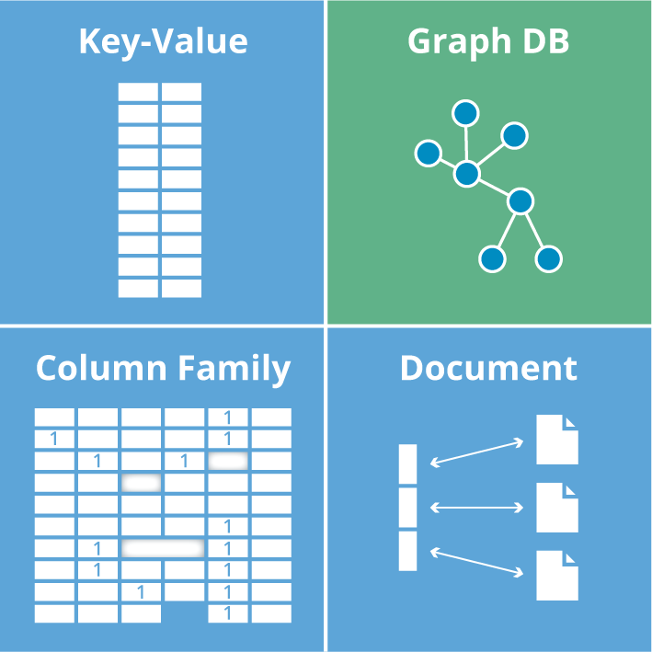
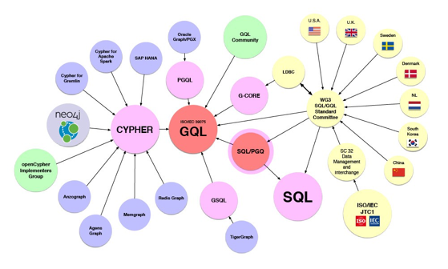








Namespaces: Encoded Symmetries in the IT industry
Image source: Graph Database for Beginners by Neo4j

Slide 8
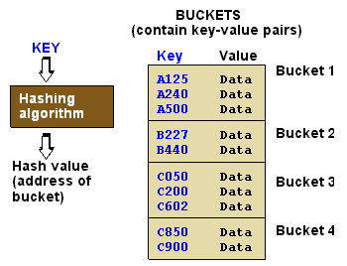

Key-Value pairs as a general form of Dictionaries/Encyclopedias
Image source: https://www.pcmag.com/encyclopedia/term/hash-table
Image source: https://librarykvjhagrakhand.wordpress.com/encyclopedia-britannica/

Slide 9
Normal Science and Namespaces
Normal Science
Model
Drift
Model Crisis
Model Revolution
Paradigm
Change
Emerging cases or
systematic attacks

Slide 10
Universal Data Abstraction
Cognitive Effectiveness can be enhanced by
a Unifying Data Abstraction

Slide 11
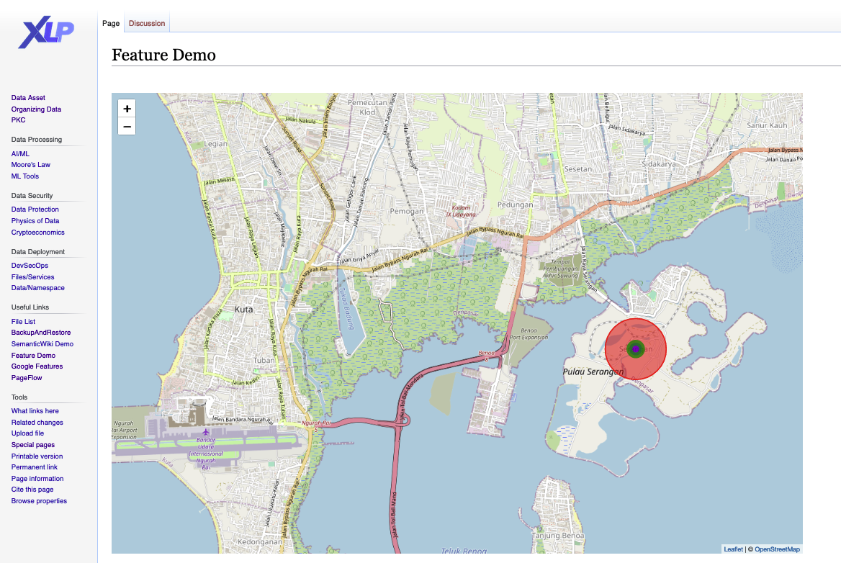



A scale-free Instrumentation for managing terms...
Global/Centralized Knowledge Container (Bodleian)
Personal/Project Knowledge Container (PKC)
A Digital Media Library based on Industrial Strength Technology/Data Standards:
Notes:
(notes)
In the process of data model/information approximation, UDA maybe judged by three conditions: Soundness, Termination, and “Relative” Precision.
All three properties can be teased out of manipulating Lattices/Partially Ordered Sets (POs), which are constructed out of key-value pairs.

Slide 12
Representability
“Everything should be made as simple as possible,
but not simpler.”
Albert Einstein
Data Governance:
A sound data practice that attains
precise,
yet terminable*
Data Asset Management.
Footnote: *Terminability: data collected is bound to work within finite resources

Slide 13
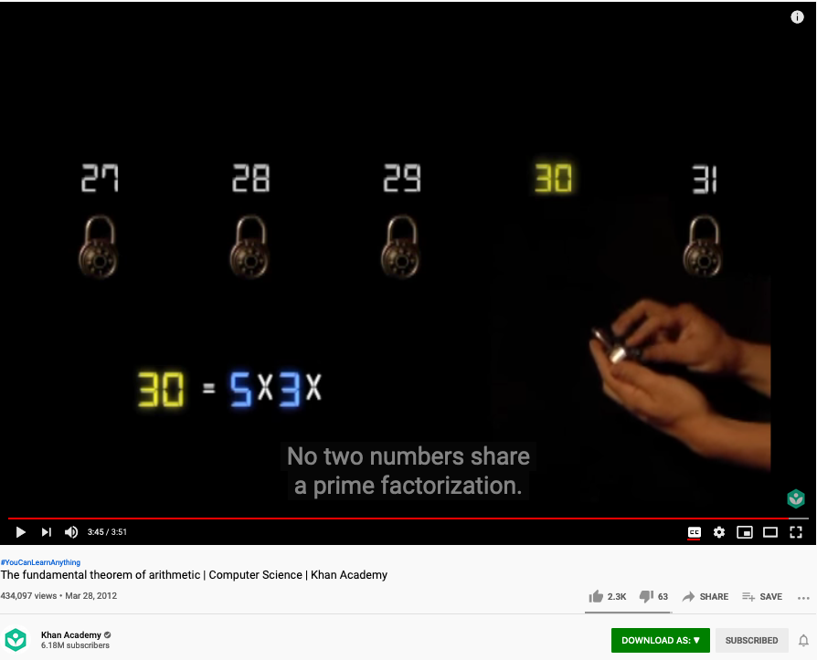
The Fundamental Theorem of Arithmetic (Name Space Management Trick)
Examples of Representability (I)
Huawei VP Mr. Yang Shaoqing
https://youtu.be/8CluknrLeys?t=225
The fundamental theorem of arithmetic | Computer Science | Khan Academy

Slide 14
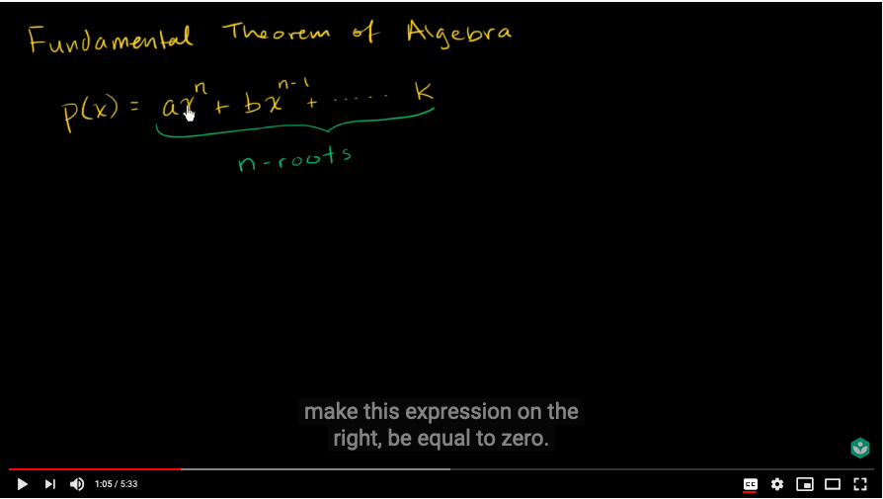
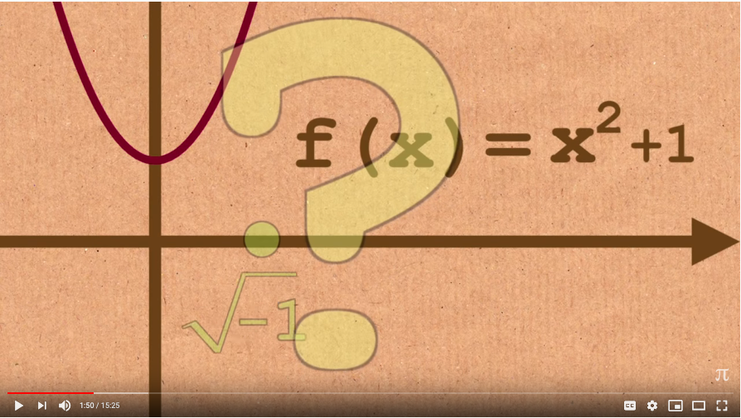
The Fundamental Theorem of Algebra
Examples of Representability (II)
Huawei VP Mr. Yang Shaoqing
https://youtu.be/d8-LO6FCna0?t=65
https://youtu.be/shEk8sz1oOw?t=110
Fundamental theorem of algebra | Khan Academy
Fundamental Theorem of Algebra - Numberphile

Slide 15
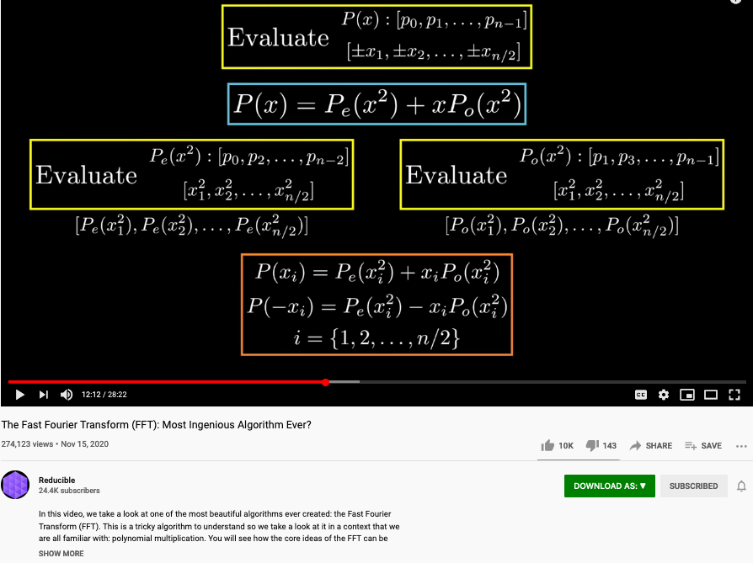
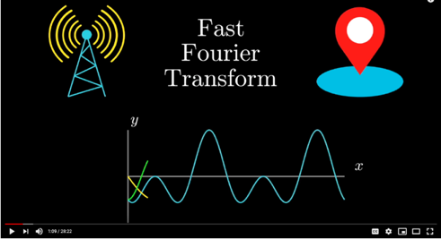
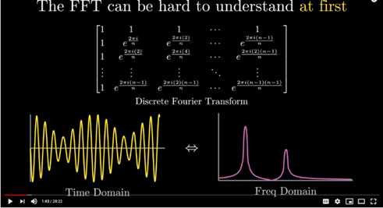
The Polynomial that appears in Fast Fourier Transform
Examples of Representability (III)
Huawei VP Mr. Yang Shaoqing
https://youtu.be/h7apO7q16V0?t=732

Slide 16




















Representability at scale = Accountable Namespaces
Account
File
Page
Service

Slide 17



Data Asset Classification
File
Page
Service
MediaWiki /Personal Knowledge Container
Institutionalized Data Assets (Namespaces)

Slide 18
Key-Value Data Type is a Universal Abstraction
Mapped Domains | key/value | Examples
data/data | Inputs/Outputs | Dictionary/Tabulated Data
structure/structure | algorithm/source code | Logical Structures/Functions in Software Libraries
language/language | Specification/Implementation | Source Code/Executable Binary
Notes:
Soundness (Aliveness vs Safety = Correctness)
Precision (The result has a outer boundary)
Termination (It will come to completion)

Slide 19
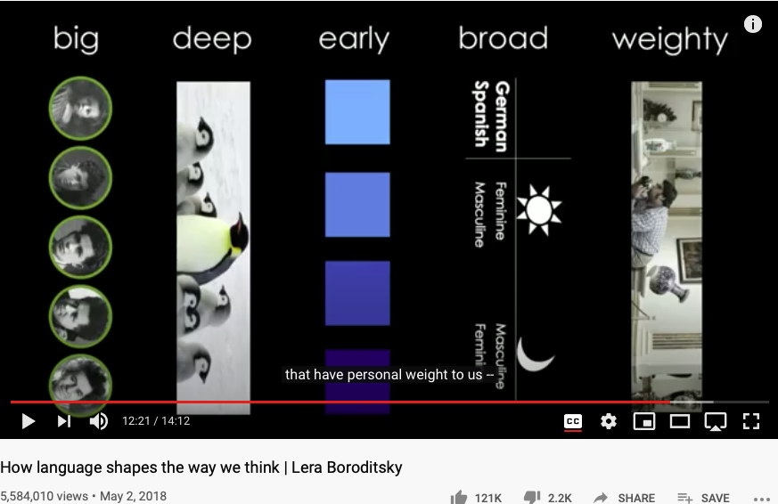
Namespaces governs Cognitive Capacity
Huawei VP Mr. Yang Shaoqing
https://youtu.be/RKK7wGAYP6k

Slide 20

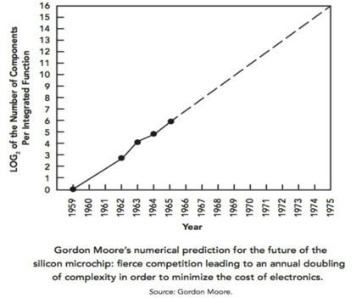

The Role of History and Ticking Clock
Normal Science
Model
Drift
Model Crisis
Model Revolution
Paradigm
Change
Emerging cases or
systematic attacks

Slide 21
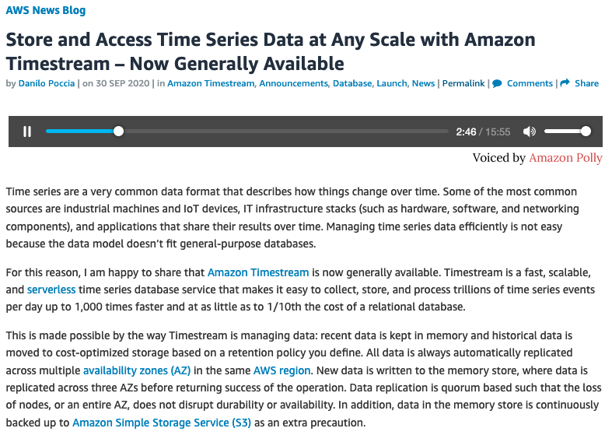
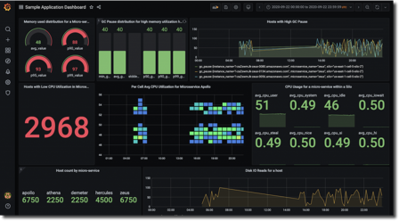
History as Ordered Events: Namespace Management in Time

Slide 22
The notion of Incommensurability
A notion of Representables
A cognitive model integrated by
Category Theory
Approximation as a part of Representational Artifacts

Slide 23
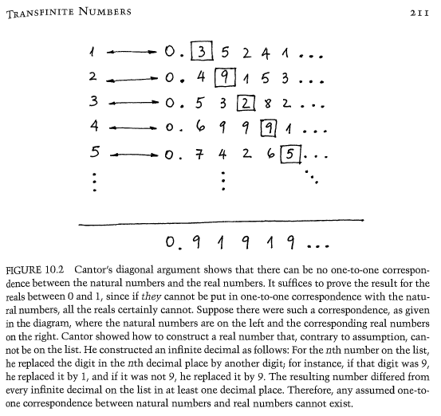
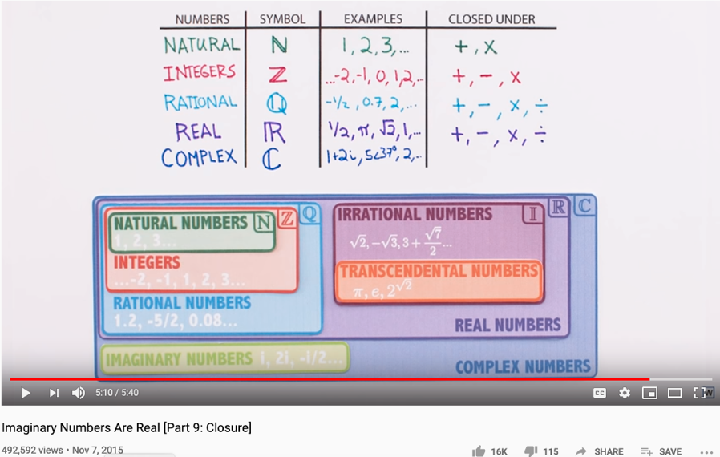
The Complete set of Generative Names
Huawei VP Mr. Yang Shaoqing

Slide 24

Arts and Sciences of NsM
History of Names
Patterns of Names
Trust-worthy Names
Namespace management (NsM) is the Foundation of Mathematical Reasoning.

Slide 25

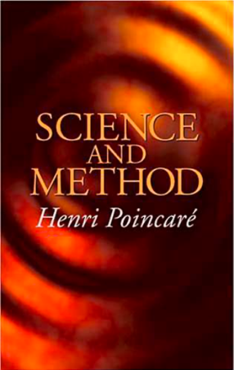
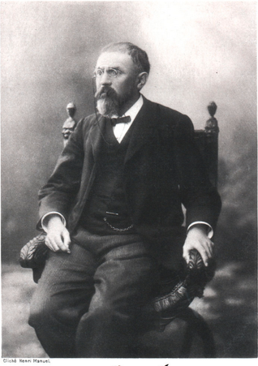
“Mathematics is the art of giving the same name to different things!” - Henry Poincare

Slide 26
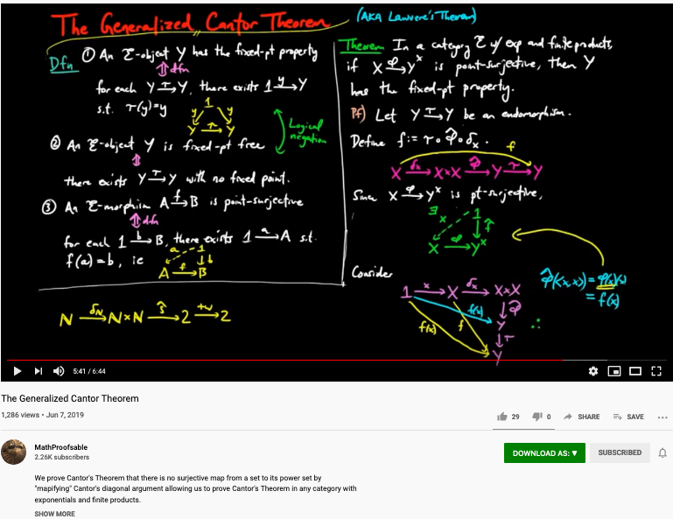
How to cope with Infinite Number of Namespaces? Category Theory to the rescue
https://youtu.be/UKIoiO9CSXU?t=341

Slide 27
Thinking in Math = Acting in Namespaces
Huawei VP Mr. Yang Shaoqing
Mathematics is the art of giving the same name to different things.^{[10]} Henri Poincaré
Bertrand Russell’s Principles of Mathematics on “Doctrine of Types”
The way to write and organize names becomes the essence.
What methods and tools can be helpful?
RICH 70 Tsinghua SEA Cloud Forum, Sep 14, 2020
H. E. Bambang Brodjonegoro,
Minister of Research & Technology, Indonesia

Slide 28
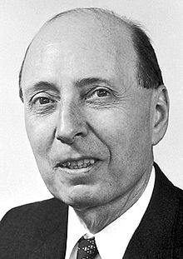
The Miracle of Math in Natural Science
"The Unreasonable Effectiveness of Mathematics in the Natural Sciences" is the title of an article published in 1960 by the physicist Eugene Wigner.^{[1]}
It is all about Name Space Management
Namespace can be compressed
It allows effective representation of both spacetime structures
Link to the original text: http://www.dartmouth.edu/~matc/MathDrama/reading/Wigner.html

Slide 29
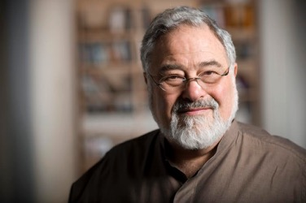
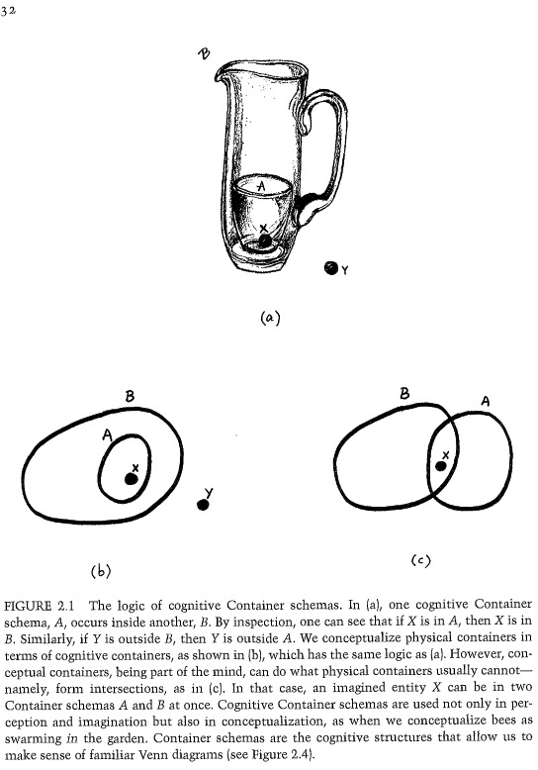
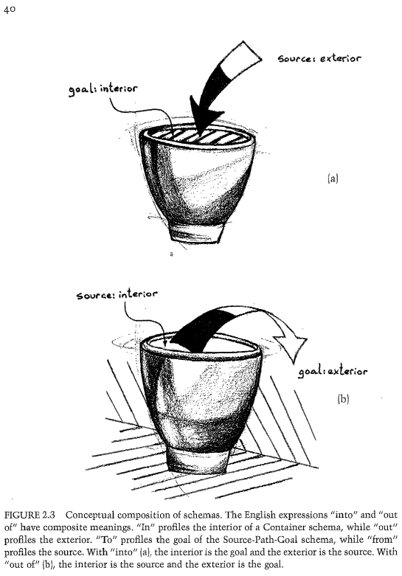
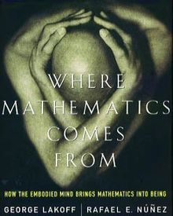
The expressive power of Names (labels)
Huawei VP Mr. Yang Shaoqing
Prof. George Lakoff

Slide 30
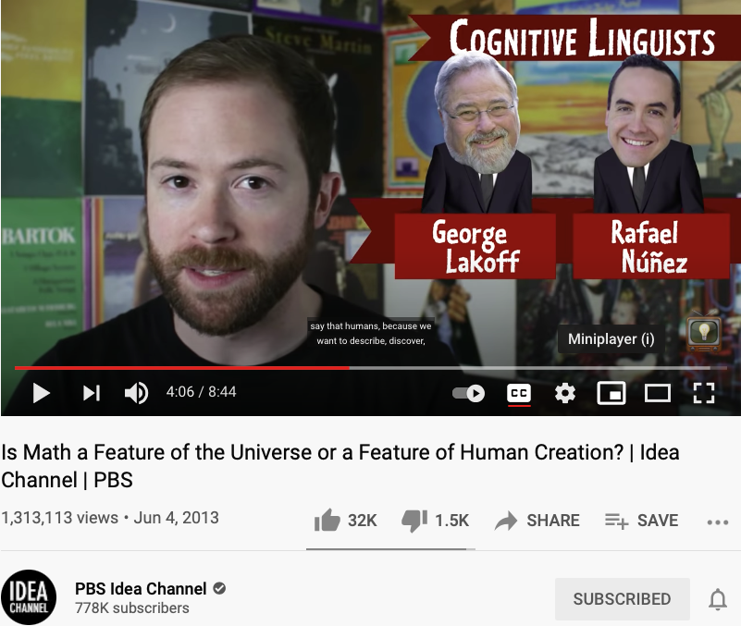
Namespaces as pure abstractions
Video Source: https://youtu.be/TbNymweHW4E?t=246

Slide 31
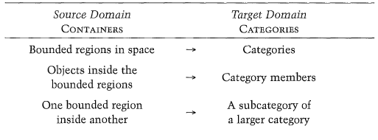
Categories are Containers of cognitive concepts
Huawei VP Mr. Yang Shaoqing

Slide 32
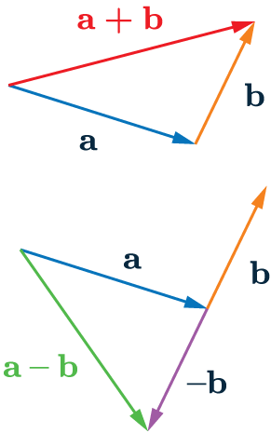
Patterns of Categories/Classification of Concepts
Grounded Ideas:
Adding (+): including objects into a collection
Subtraction (-): taking objects away from the collection
Sets: containers of elements
Abstract Ideas:
Numbers as points on a line
Geometrical figures as algebraic equations

Slide 33
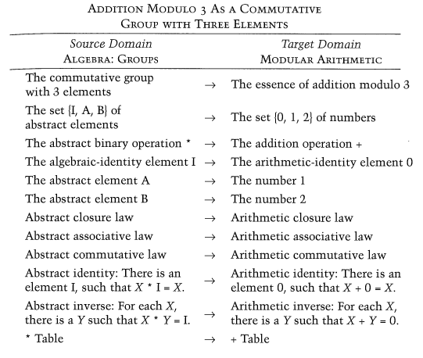
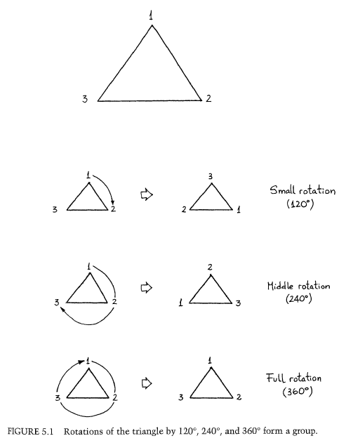
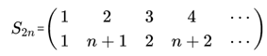
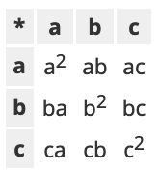
Combine Operands/Operations as constructed names?
Cayley Table

Slide 34
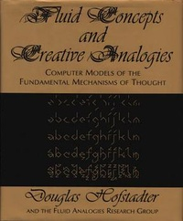
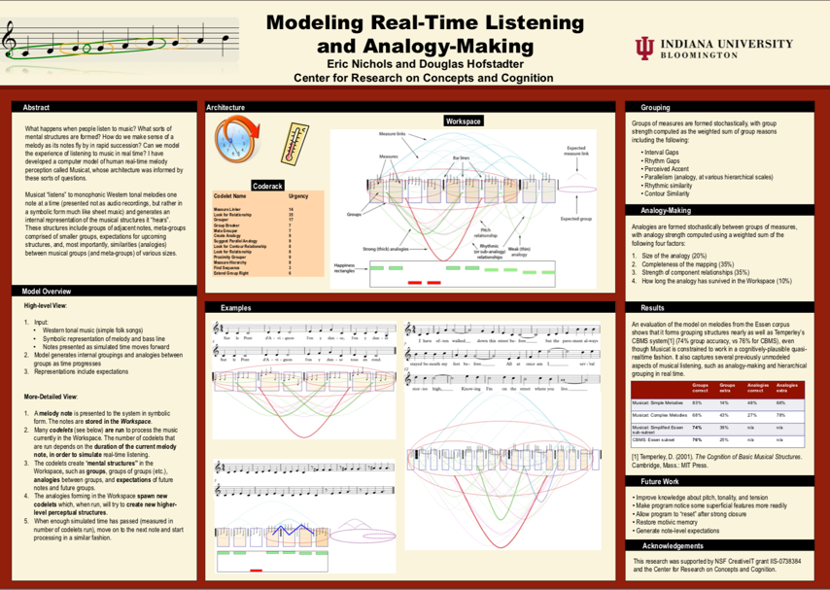
Names as Generalized Metaphors
Huawei VP Mr. Yang Shaoqing
RICH 70 Tsinghua SEA Cloud Forum, Sep 14, 2020
H. E. Bambang Brodjonegoro,
Minister of Research & Technology, Indonesia

Slide 35


The properties of being Trust-worthy name schemes
Soundness:
All names refer to at least one legal entity
Completeness:
All legal entities must all have at least one name
Controlled Access Rights
Non-repudiation:
Every name only points to one unique legal entity
Tamper-Proof:
Authorized entities can make changes
Any change to the name system must become public knowledge
Time-based:
All name changes should be time-stamped by one coherent clock
Huawei VP Mr. Yang Shaoqing
RICH 70 Tsinghua SEA Cloud Forum, Sep 14, 2020
H. E. Bambang Brodjonegoro,
Minister of Research & Technology, Indonesia

Slide 36
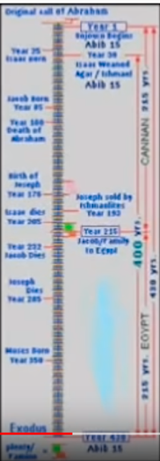
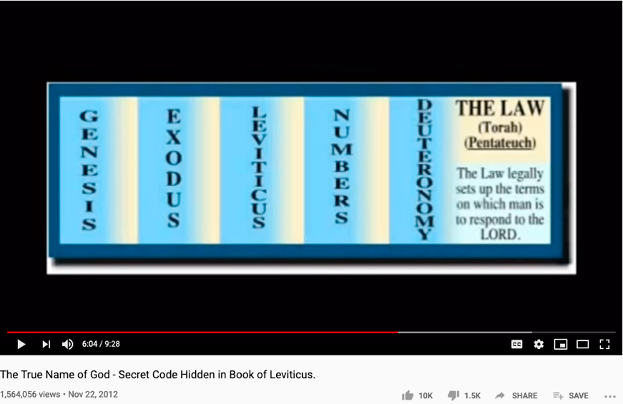
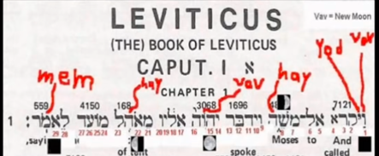
The History of True Names
Huawei VP Mr. Yang Shaoqing
RICH 70 Tsinghua SEA Cloud Forum, Sep 14, 2020
H. E. Bambang Brodjonegoro,
Minister of Research & Technology, Indonesia
How Gods are forgotten:
https://youtu.be/xgyMY9w7-ew?t=278

Slide 37
Time and Trust-worthiness in NsM
All Name Spaces should share a universal “clock”
The common “Historical-Trail” (time-based) of Name Spaces
So that the time-stamps would offer hints to cross-check “causal” consistency
Name Spaces should be extensible
It should follow one consistent naming convention for easy referencing
Kuhn’s Cycle provides a Generative/Cyclic Model
Name Space Authentication should be scalable and distributed
Existing mechanisms for authenticated name registration, i.e. Domain Name Services (DNS).

Slide 38
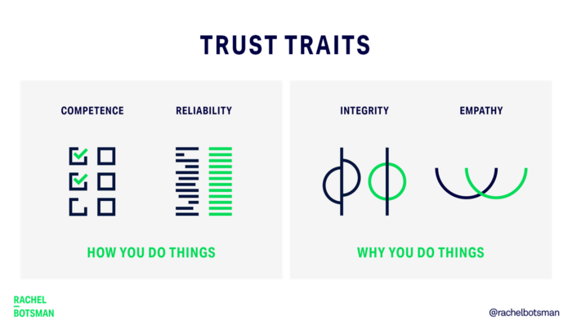
Trust-worthy Name Space?
Competence:
What can you deliver?
Reliability:
Success rate of delivery?
Integirty:
Will you ever cheat me?
Empathy:
Are you on my side?
Being More Trustworthy: The Basics
― Rachel Botsman, Jan 14, 2019

Slide 39
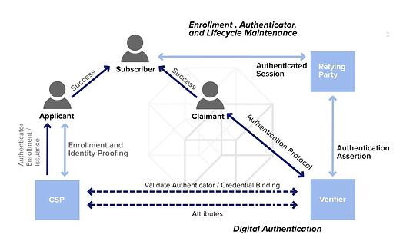
Authenticated Name Space?
Digital Authentication - the basics
― Dawn M. Turner (guest) on 01. August 2016

Slide 40
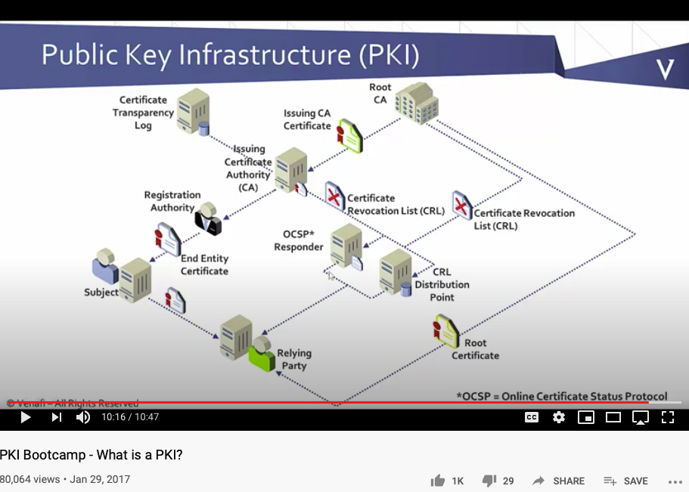
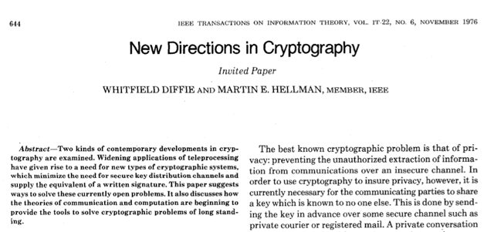
Public-Private Key NsM Infrastructures
The paper that changed
the direction of NsM!
What is Private Key Infrastructure?

Slide 41
Universal Representation
Huawei VP Mr. Yang Shaoqing
RICH 70 Tsinghua SEA Cloud Forum, Sep 14, 2020
H. E. Bambang Brodjonegoro,
Minister of Research & Technology, Indonesia

Slide 42
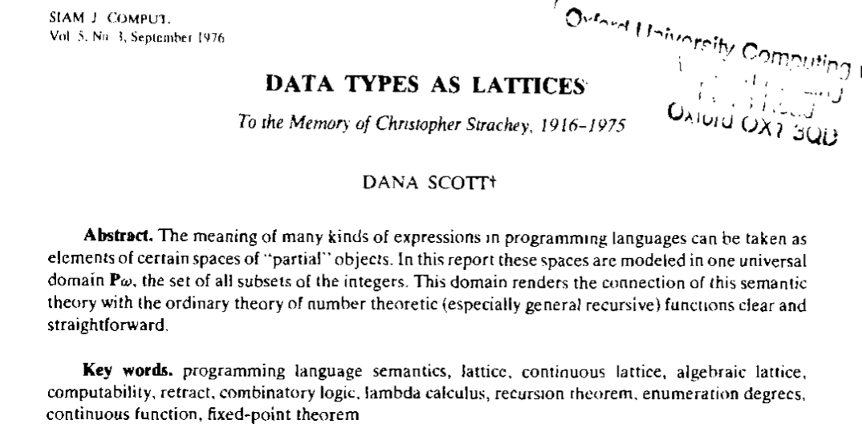
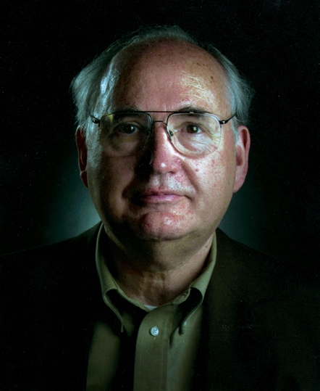
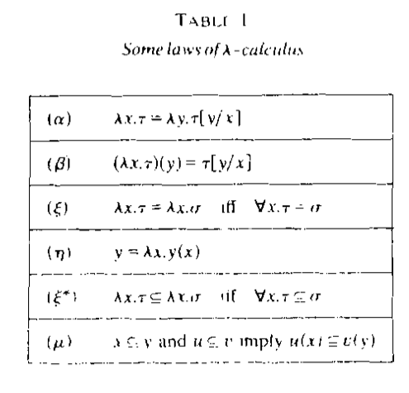


All meaningful expressions can be modeled as $𝒫ω$
Key
Value
Prof. Dana Stewart Scott
Hyperlink
Image Source: Britannica
why directed link is a form of universal data abstraction

Slide 43
In Pure Computation: Function is the ONLY thing.
Primitive Func
Func1
Func2
𝜆
fVar
Func(fVar…)
( )
Functions

Slide 44
The Universal Structure in 𝜆-Calculus Form
Expression := Contextualized Data (* Known interpretation results, no computation *)
| Goal_Exp Criteria_Exp (* Timeless and Time-based expressions *)
| 𝜆 Input Output_Exp(Input) (* A Computing Process *)
| ( Exception_Handling ) (* Stated boundary conditions/Exceptions *)
This set of rules can be used recursively to generate an infinite amount of expressions.
What
Contextualized data
Goal Expr
Criteria Expr
Why
𝜆
Input
Output Spec
How
( )
Exception Handling

Slide 45
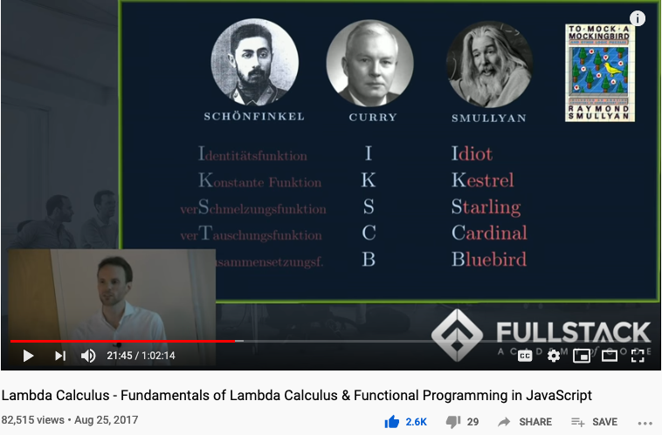
Computable Logic and Types of “Birds”

Slide 46
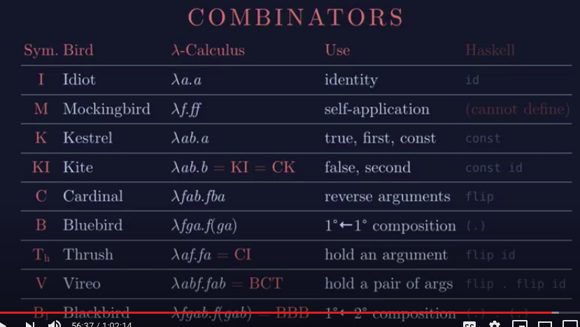
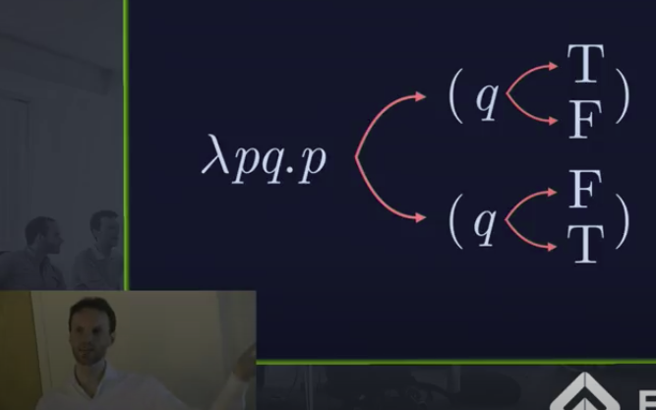
The Names of Birds (Functions)

Slide 47
A Logic Model is a Function
Context: Describe the Spatial and Temporal boundaries of the project.
Abstract Specification
Goal: Mission Statement written in an imperative sentence with reference to “Context”.
Measurable Effects: Conditional statements of the observable implementation outcomes that satisfy the “Goal”.
Concrete Implementation Process
Outputs
A list of noun phrases that declares the deliverable items from proposed activities
Activities
A structured set of actions that depicts implementation activities.
Ideally written in a formalized process specification language
Inputs
Prescribe the required resources to be consumed in the implementation Process
Boundary Conditions: When and how the boundaries of the previously defined ”Context” could be broken?

Slide 48
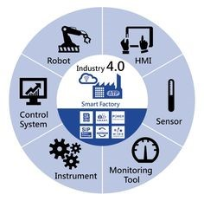
NsM at Scale!
Relations on the Web
URL: Universal Resource Locator
Universal Data Formats
Physical Objects connected through Namespaces

Slide 49


The Tool for NsM
MediaWiki as a Tool
Data in MediaWiki/Wikipedia
Templates and Categories
Structures and Strategies in Namespace Management

Slide 50





Namespace Management on the Global Scale
Berners-Lee called his vision for the web “utopian.”
He wanted it to be a place where all people had access to the best information at any time.

Slide 51





The origin and the Future of the “Web”
Theodore Gray created an Editable Interface for Computable Documents.
The technology is based on Mathematica, and was bundled with NeXT computers used by Berners-Lee.
Notes:
Wolfram|Alpha demo phrase
China's GDP over the sum of GDP of Japan and USA

Slide 52



Diffbot (more than 1 Trillion linked entities)

Slide 53




Namespace Management with Open AI
An “open” Artificial Intelligence resource that is available for “free”.
It will do your software development work for you for free, too.

Slide 54


The current champion in NsM at Scale
GPT-3 A very large vocabulary to date
An earlier industrialized computable vocabulary
175 Billion Parameters

Slide 55

Chinese Pre-Trained Neural Network
https://cpm.baai.ac.cn

Slide 56

Another Chinese Pre-Trained Neural Network
https://git.openi.org.cn/PCL-Platform.Intelligence/PanGu-Alpha

Slide 57

Another Neural Network Open Source Tool
https://jina.ai

Slide 58



Naming your Learning Actions

Slide 59
Summary of Namespace Management
NsM: Artificially assign names to historically recognized IDs:
Ontology/本体论: the philosophical study of being. (Wikipedia)
Epistemology/知识论: a theory of knowledge, (Standord Philosophy Encyclopedia)
Universal Resource Locator/Indicator(URL/URI) : a string representing global resources
Cognitive capacity is limited by Representability (NsM)
CAP Theorem: Consistency, Availability, and Performance face contentious tradeoffs.
System properties: Correctness = Liveness * Safety, Trust-worthy Data

Slide 60
Your action on NsM before Sep 29, 2021
Start using Templates and Categories on toyhouse.wiki:81
Create a personal page with bio, using standardized Templates and Category
Make sure all Wiki pages you created follow the same Namespace convention
Start using Github to download and share files with proper NsM
Couse Github @ https://github.com/benkoo/CognitiveFoundation2020
Start writing your learning report.
Every week should include Logic Model using the standard Template
500 words or more per week

Slide 61
Backup Slides

Slide 62


Unified Namespace

Slide 63


Get access to Live Data Now!
https://www.flightradar24.com/
https://www.marinetraffic.com/

Slide 64



An example of Namespace Management

Slide 65
What is the minimum Symbol Space?
Huawei VP Mr. Yang Shaoqing

Slide 66
Is binary valued system the smallest symbol set?
Huawei VP Mr. Yang Shaoqing

Slide 67

Memoization
An important technique to manage names dynamically!

Slide 68
Maybe we should teach Math in a different sequence
The notion of Pureness
Approximation to Idealized Truth
A curriculum modeled after
Curry-Howard-Lambek Correspondence

Slide 69

Number Theory, Physics, and Geometry
Huawei VP Mr. Yang Shaoqing
RICH 70 Tsinghua SEA Cloud Forum, Sep 14, 2020
H. E. Bambang Brodjonegoro,
Minister of Research & Technology, Indonesia
Ninhyong Kim has been a research professor of number theory at the University of Oxford and the head of their number theory research group.

Slide 70

The origin of Atomic Elements
Huawei VP Mr. Yang Shaoqing
RICH 70 Tsinghua SEA Cloud Forum, Sep 14, 2020
H. E. Bambang Brodjonegoro,
Minister of Research & Technology, Indonesia

Slide 71


The known set of Elementary Particles
Huawei VP Mr. Yang Shaoqing
RICH 70 Tsinghua SEA Cloud Forum, Sep 14, 2020
H. E. Bambang Brodjonegoro,
Minister of Research & Technology, Indonesia

Slide 72

The way medical doctors talks about Human Anatomy
Huawei VP Mr. Yang Shaoqing

Slide 73


How musicians “assign names” to Music
Huawei VP Mr. Yang Shaoqing
RICH 70 Tsinghua SEA Cloud Forum, Sep 14, 2020
H. E. Bambang Brodjonegoro,
Minister of Research & Technology, Indonesia

Slide 74



How topologists “assign names” to Music
Huawei VP Mr. Yang Shaoqing
RICH 70 Tsinghua SEA Cloud Forum, Sep 14, 2020
H. E. Bambang Brodjonegoro,
Minister of Research & Technology, Indonesia
More information about this series: https://www.springer.com/series/8349

Slide 75

A Way to Get Internet Domain Name Service
Huawei VP Mr. Yang Shaoqing

Slide 76


NsM in Loops and Recursion

Slide 77


Another Round at Recursion

Slide 78

First Approximation If there are called the same name, they must be equal.
For example …

Slide 79

Definitional Suggestion for Computing Science

Slide 80





The man who redefined Equal in Math!
By Kevin Hartnett
Vladimir Voevodsky

Slide 81

Review the history of Algebraic Topology
Prof. Pierre Albin

Slide 82

The foundation of math as programming languages
Prof. Robert Harper

Slide 83


Memoization: Remember Generated Names

Slide 84

Lecture Outline

Slide 85


The Meaning of being True
Huawei VP Mr. Yang Shaoqing
RICH 70 Tsinghua SEA Cloud Forum, Sep 14, 2020
H. E. Bambang Brodjonegoro,
Minister of Research & Technology, Indonesia
Russel once said: “Mathematicians’ job is about classifiying.”
Mathematics is the art of giving the same name to different things.^{[10]} Henri Poincaré

Slide 86


The Necessity of Named abstractions
Huawei VP Mr. Yang Shaoqing
Through abstraction, only compute truth within the domain of interest!
So that it can by pass the Halting Problem.

Slide 87

How to Think Mathematically?
Huawei VP Mr. Yang Shaoqing
RICH 70 Tsinghua SEA Cloud Forum, Sep 14, 2020
H. E. Bambang Brodjonegoro,
Minister of Research & Technology, Indonesia
Russel once said: “Mathematicians’ job is about classifiying.”
Mathematics is the art of giving the same name to different things.^{[10]} Henri Poincaré

Slide 88

True Name defined by Wikipedia

